Slide 1
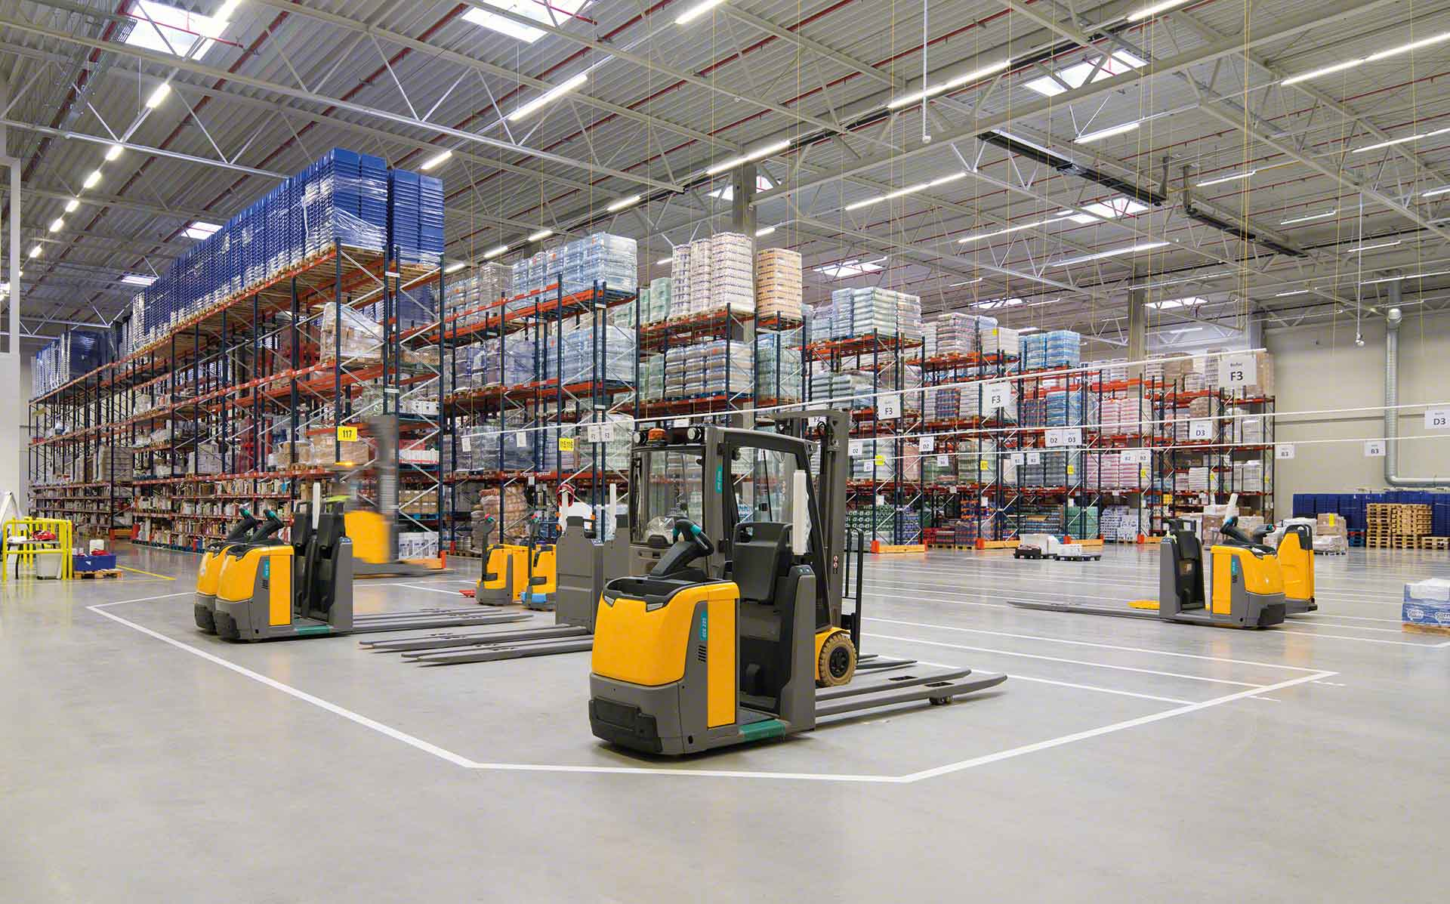

Material Handling KPI
November 2022

Slide 2
Material Handling moves
Row Labels | Sum of CYCLE COUNTS | Sum of MAT HANDLE | Sum of TOTAL
amiranda | 2 | 297 | 299
jodelacr | 10 | 223 | 233
jtobias | 2 | 172 | 174
erojas | 0 | 143 | 143
judelato | 0 | 125 | 125
Grand Total | 14 | 960 | 974
Total movements
974

Slide 3
Material Handling moves
LOC TYPE | RTID percentage difference
OT/OR/OZ | -85.62%
FP | 46.03%
Proveedores | 30.82%
OS | -54.72%
SP | -3.01%
Grand Total | 2.23%
disminuyo un 85 porciento la cantidad de picks que se hacen de la OT OR OZ
Aumento la cantidad de floor picks un 46%
hubo un 30% de incremento en recepcion de proveedores
Disminuyo un 54% la cantidad de picks realizados de Overstock
a disminuido un 3% la cantidad de picks small part
en general a existe un aumento del 2% desde el 1 al 12 de enero

Slide 4
Adjustments
Row Labels | Sum of COST | Count of PART
amiranda | 33.67 | 2
jodelacr | 486.82 | 10
jtobias | 4085.46 | 2
Grand Total | 4605.95 | 14
Adjustments difference
$4605.95

Slide 5
Labor intensive
Class not slotted count
8
Labor Intensive
16

Slide 6
Distribution efficiency
Low Max
651
Labor Intensive
1437

Slide 7
restock
Row Labels | Count of Part Number
Jan
2-Jan | 36
3-Jan | 56
4-Jan | 24
5-Jan | 39
6-Jan | 36
Grand Total | 191
Part Numbers stocked
191

Slide 8
Empty locations
Row Labels | Sum of Total de espacios disponibles
Dec
5-Dec | 350
12-Dec | 328
19-Dec | 255
23-Dec | 296
28-Dec | 295
Grand Total | 1524
Actual empty locations
295

Slide 9
Discrepancies
Date | Sum of Locaciones
sep | 78
02-sep | 25
05-sep | 15
16-sep | 15
23-sep | 10
30-sep | 13
oct | 27
07-oct | 5
14-oct | 0
28-oct | 9
31-oct | 13
nov | 35
02-nov | 12
04-nov | 5
08-nov | 2
11-nov | 4
14-nov | 4
17-nov | 3
22-nov | 5
25-nov | 0
Grand Total | 140
Total discrepancies
0

Slide 10
Consolidation
Row Labels | Sum of count of consolidations
14/08/2022 | 27
28/09/2022 | 24
06/10/2022 | 35
13/10/2022 | 26
20/10/2022 | 20
27/10/2022 | 29
17/11/2022 | 18
24/11/2022 | 15
Grand Total | 194
Total Consolidations
194

